Slide 1
MLFlow In Azure
Anthony Franklin, PhD
Sr. Cloud AI Engineer

Slide 2

Recording Session is in Progress
If you prefer us not to include you in the recording, please drop off now.

Slide 3
Smart Hospital
Keren Priyadarshini

Slide 5

Welcome to
For more information on additional sessions, content recording, and slide decks, visit http://aka.ms/WinterSpark

Slide 6
Session learning objective
At the end of this session, you should be better able to…
[Learning Objective 1]
This slide is required. Do NOT delete.
Please expand notes window at bottom of slide and read. Then Delete this text box.
Notes:
This slide is required. Do NOT delete. This should the first slide in your presentation after your session opening.
This slide should be part of your session opening and introduce what the learner will be better able to do as a result of attending this session.
You should have no more than 3 learning objectives for your session. Best practice: 1 Learning objective for 60 minute session. Aim for depth vs. breadth.
Good learning objectives should be learner centric, start with a verb (e.g., articulate, demonstrate, deliver, architect, troubleshoot, design) and be S.M.A.R.T (specific, measurable, achievable, realistic, time-bound). The learning objective should define a desired learner behavior (NOT what you are going to present).
The learning objectives on this slide should match those defined and published for your session on the SPARK session submission form.

Slide 7
Text layout (without bullet points)
Main topic: Segoe UI, size 28pt
Segoe UI, size 20pt for second level
Segoe UI, size 16pt for third level

Slide 8
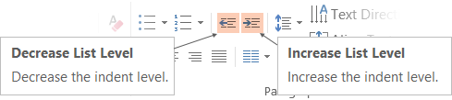
Adjusting list levels
Main topic: Segoe UI, size 28pt
Segoe UI, size 20pt for second level
Segoe UI, size 16pt for third level
Use the “Decrease List Level” and “Increase List Level” tools on the Home menu to change text levels.
Try this:
Place your cursor in the line of text that says “Segoe UI, size 20pt for second level”
Next click the Home tab, and then on the “Decrease List level” tool. Notice how the line moves up one level.
Now try placing your cursor in one of the top “Main topic…” line of text. Click the “Increase List Level” tool and see how the text is pushed in one level.
Use these 2 tools to adjust your text levels as you work

Slide 9
Example with longer headline text wrapping to a second line
When the headline text is 2 lines, move this text block down to align to the lower blue guide
If you don’t see guidelines, click on the View menu, and then check the box in front of “Guides”
Use a “soft return” Shift + Enter to wrap text without adding extra line spacing

Slide 10
Bullet points layout with subtitle Set the subtitle to 20pt in the same text block, with character spacing Normal
Move the text block down vertically to align to lower guide
If you don’t see guidelines, click on the View menu, and then check the box in front of “Guides”
Hyperlink style: www.microsoft.com

Slide 11
Title square photo layout
Smaller text

Slide 12
Square photo layout

Slide 13
Section title

Slide 14
Section title

Slide 15
Section title

Slide 16
Section title

Slide 17
Section title

Slide 18
Section title

Slide 19
Demo
Speaker name

Slide 20
Community Banner

Slide 21
Flow
Intro to Model Lifecycle
MLFlow 101
Why MLFlow & Azure?
Demo
How to Position MLFlow to Partners
Q&A
Notes:
This is not to teach data science
This is not to teach DevOps
This is not to make you an expert at MLFlow

Slide 22
ML Model Lifecycle
Source: Azure Machine Learning Services

Slide 23
ML Lifecycle Challenges
It’s difficult to keep track of experiments.
It’s difficult to reproduce code.
There’s no standard way to package and deploy models.
There’s no central store to manage models (their versions and stage transitions).
Notes:
It’s difficult to keep track of experiments. When you are just working with files on your laptop, or with an interactive notebook, how do you tell which data, code and parameters went into getting a particular result?
It’s difficult to reproduce code. Even if you have meticulously tracked the code versions and parameters, you need to capture the whole environment (for example, library dependencies) to get the same result again. This is especially challenging if you want another data scientist to use your code, or if you want to run the same code at scale on another platform (for example, in the cloud).
There’s no standard way to package and deploy models. Every data science team comes up with its own approach for each ML library that it uses, and the link between a model and the code and parameters that produced it is often lost.
There’s no central store to manage models (their versions and stage transitions). A data science team creates many models. In absence of a central place to collaborate and manage model lifecycle, data science teams face challenges in how they manage models stages: from development to staging, and finally, to archiving or production, with respective versions, annotations, and history.
Moreover, although individual ML libraries provide solutions to some of these problems
(for example, model serving), to get the best result you usually want to try multiple ML libraries.
MLflow lets you train, reuse, and deploy models with any library and package them into reproducible
steps that other data scientists can use as a “black box,” without even having to know which library you are using.

Slide 24

MLFlow 101

Slide 25
What is MLFlow?
Competitors
Open source platform to manage the ML lifecycle:
Experimentation
Reproducibility
Deployment
Central Model Registry
“I build 100s of models/day to lift revenue, using any library: MLlib, PyTorch, R, etc. There’s no easy way to see what data went in a model from a week ago, tune it and rebuild it.”
-- Chief scientist at ad tech firm

Slide 26
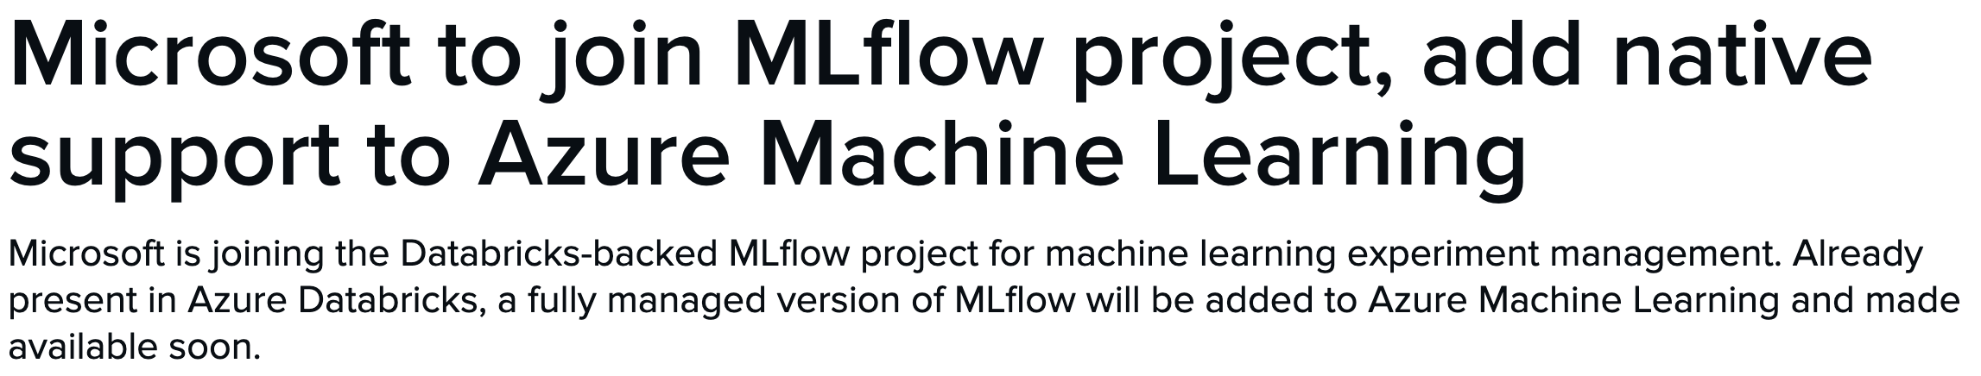
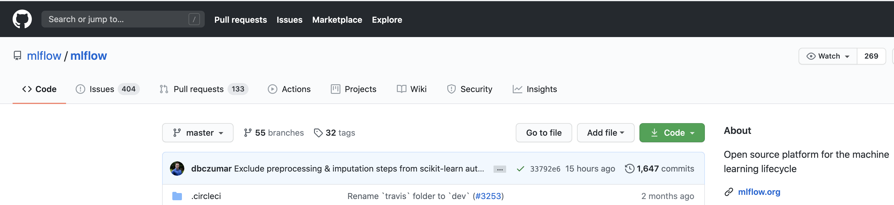
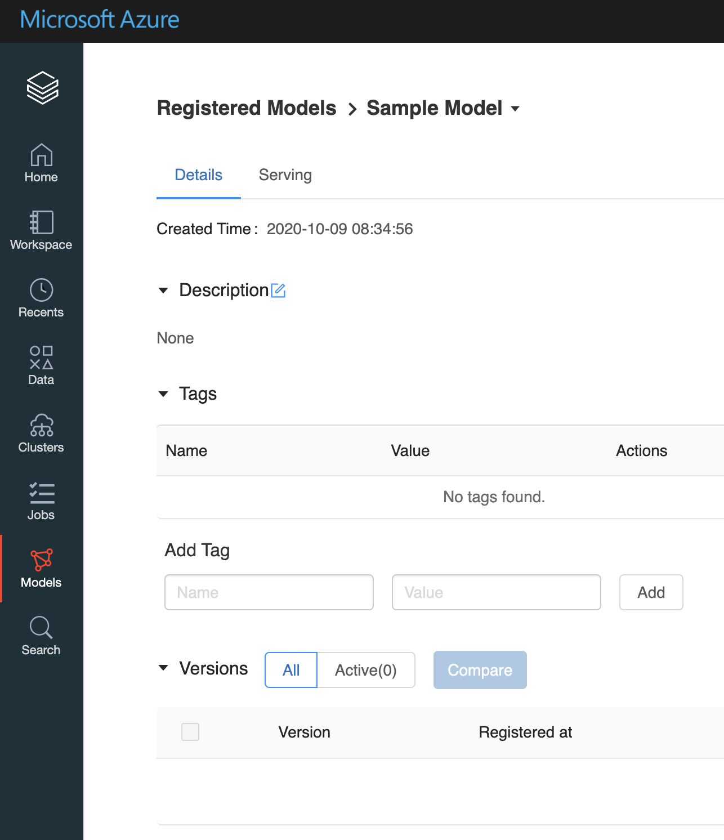
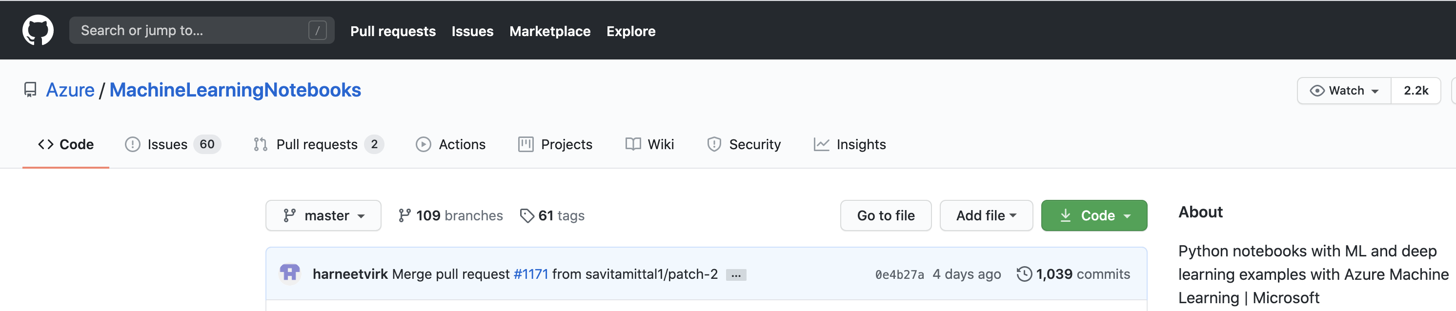
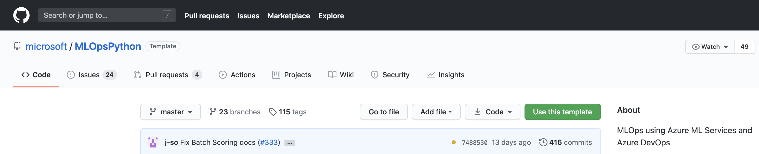
Azure Databricks
1,647
1,039
416

Slide 27
*
*Recent updated features

Slide 28

MLFlow Tracking
NOTEBOOK
Python or
REST API
UI
LOCAL APP
Tracking Server
CLOUD JOB
API
Tracking Store
Artifact Store

Slide 29
MLFlow Projects
Project Spec
Local Execution
Code
Config
Data
Remote Execution

Slide 30
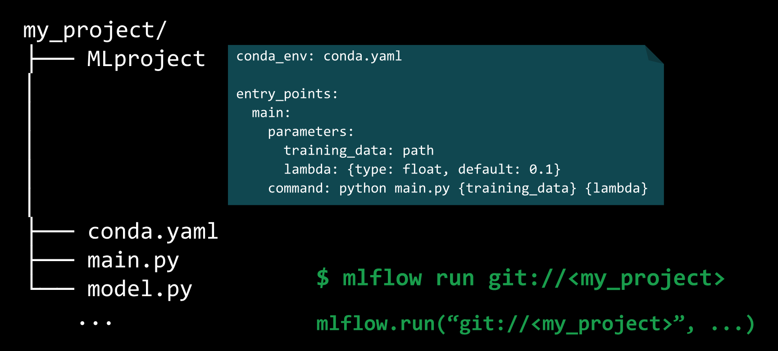
Example For Model Packaging
Notes:
There are a number of different reasons why teams need to package their machine learning projects:
Projects have various library dependencies so shipping a machine learning solution involves the environment in which it was built. MLflow allows for this environment to be a conda environment or docker container. This means that teams can easily share and publish their code for others to use.
Machine learning projects become increasingly complex as time goes on. This includes ETL and featurization steps, machine learning models used for pre-processing, and finally the model training itself.
Each component of a machine learning pipeline needs to allow for tracing its lineage. If there's a failure at some point, tracing the full end-to-end lineage of a model allows for easier debugging.
ML Projects is a specification for how to organize code in a project. The heart of this is an MLproject file, a YAML specification for the components of an ML project. This allows for more complex workflows since a project can execute another project, allowing for encapsulation of each stage of a more complex machine learning architecture. This means that teams can collaborate more easily using this architecture.

Slide 31


MLFlow Models
Model Registry
Flavor 1
Flavor 2
Standard for ML Models
ML Frameworks
Serving Tools

Slide 32
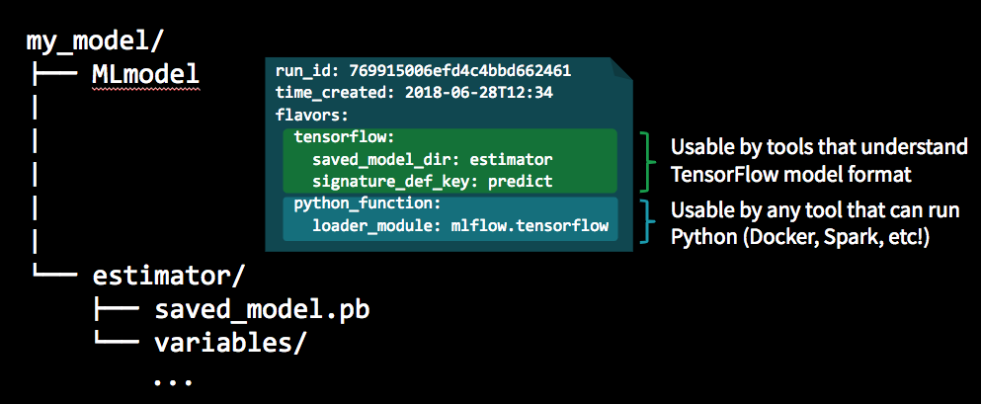
Example of Model Management
Notes:
Flavors offer a way of saving models in a way that's agnostic to the training development, making it significantly easier to be used in various deployment options. Some of the most popular built-in flavors include the following:

Slide 33
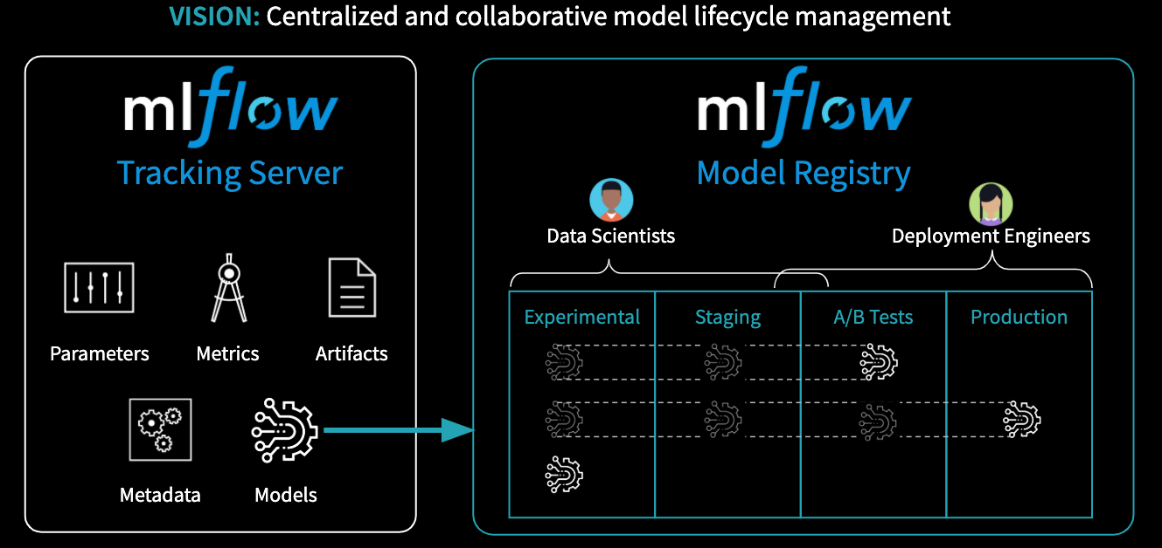
MLFlow Model Registry
Notes:
The MLflow Model Registry component is a centralized model store, set of APIs, and UI, to collaboratively manage the full lifecycle of an MLflow Model. It provides model lineage (which MLflow Experiment and Run produced the model), model versioning, stage transitions (e.g. from staging to production), annotations (e.g. with comments, tags), and deployment management (e.g. which production jobs have requested a specific model version).
Model registry has the following features:
Central Repository: Register MLflow models with the MLflow Model Registry. A registered model has a unique name, version, stage, and other metadata.
Model Versioning: Automatically keep track of versions for registered models when updated.
Model Stage: Assigned preset or custom stages to each model version, like “Staging” and “Production” to represent the lifecycle of a model.
Model Stage Transitions: Record new registration events or changes as activities that automatically log users, changes, and additional metadata such as comments.
CI/CD Workflow Integration: Record stage transitions, request, review and approve changes as part of CI/CD pipelines for better control and governance.

Slide 34

Why MLFlow & Azure?

Slide 35
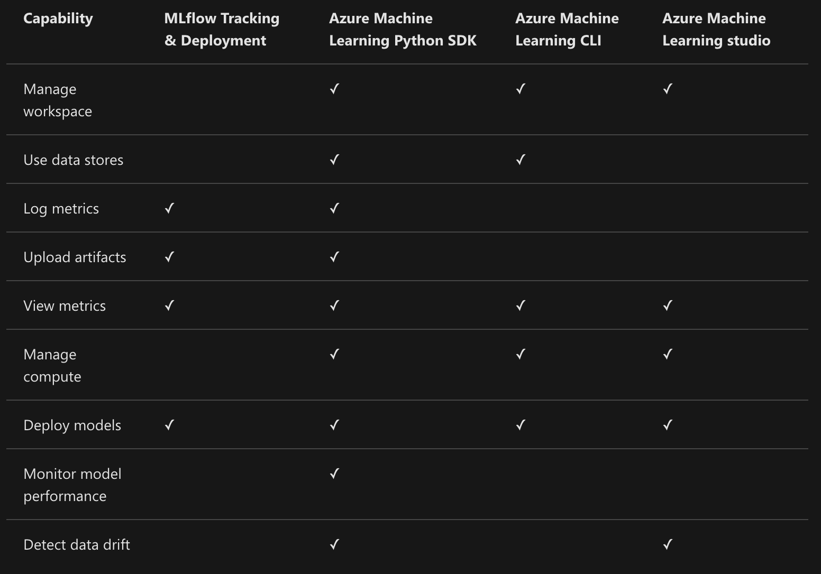
MLFlow vs Azure ML
Feature Rich
Platform Services
Manage Compute
Data Monitoring
<IMAGE>
Platform Flexibility
Multi-cloud
Multiple ML Frameworks

Slide 36
Azure ML
Data Monitoring
Parametrized Compute Targets

Slide 37
MLFlow in Azure ML

Slide 38
Demo

Slide 39
Position To Partners

Slide 40

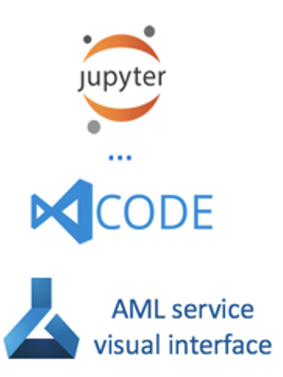

Scenario 1
Bring MLFlow To Azure ML
Customer’s Azure Architecture
Customer’s Azure Machine Learning Service
Prep
Experimentation
Deploy
Tracking

Slide 41
Scenario 2
Bring Azure Resources To MLFlow
Customer’s Azure Architecture
Customer’s Data Science Team**
V-Net
Tracking
Data
Projects
Models
**Could be local or other cloud

Slide 42
Q&A

